Slide 1
Data Structures C/C++ Review

Slide 2
Outline
Data structures defintion
Arrays
Pointers and Dynamic Memory Allocation
Object-Oriented Programming
Basic concepts: class, object
Encapsulation
Inheritance
Polymorphism

Slide 3
Data Structures: Definition
A collection of data elements whose organization is characterized by accessing operations that are used to store and retrieve the individual data elements;
The logical arrangement of data as used by a system for data management; a representation of a data model in computer form

Slide 4
Data Structures: More specifically
A data structure is a way of grouping fundamental types (like integers, floating point numbers, and arrays) into a bundle that represents some identifiable thing.
For example, a matrix may be thought of as the bundle of the number of rows and columns, and the array of values of the elements of the matrix. This information must be known in order to manipulate the matrix.
C introduced the struct for declaring and manipulating data structures. C++ extended the struct to a class

Slide 5
Goals of Data structures
Identify and develop useful mathematical entities and operations and to determine what classes of problems can be solved by using these entities and operations.
Determine representation of those abstract entities and to implement the abstract operation on these concrete representations.

Slide 6
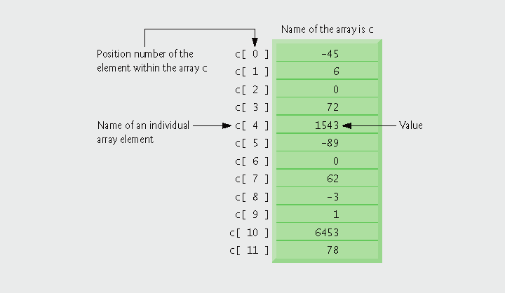
Array
Arrays are data structures containing related data items of same type.
An array is a consecutive group of memory locations.

Slide 7
Declare an Array
Declaration of an array:
type arrayName[ arraySize ];
Example
int c[ 12 ];
arraySize must be an integer constant greater than zero.
type specifies the types of data values to be stored in the array: can be int, float, double, char, etc.

Slide 8
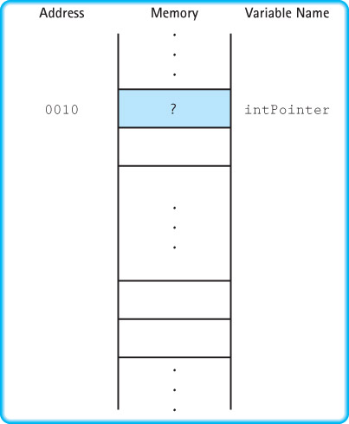
Useful Memory Diagram

Slide 9
Elements of An Array
To refer to a particular location or element in the array, we specify:
name of the array
index of the element: integer or integer expression, with value larger than or equal to 0.
First element has index zero.
Example
C[0] += 2;
C[a + b] = 3;

Slide 10
Example
An array c has 12 elements ( c[0], c[1], … c[11] ); the value of c[0] is –45.

Slide 11
Initialize Array with Initializer List
Initializer list: items enclosed in braces ({}) and separated by commas.
Examples
int n[ 5 ] = { 10, 20, 30, 40, 50 };
int m[ 5 ] = { 10, 20, 30 };
The remaining elements are initialized to zero.
int p[ ] = { 10, 20, 30, 40, 50 };
Because array size is omitted in the declaration, the compiler determines the size of the array based on the size of the initializer list.

Slide 12
Initialize an Array Using a Loop
Using a loop to initialize the array’s elements
Declare array, specify number of elements
Use repetition statement to loop for each element
Example:
int n[10];
for ( int i = 0; i < 10; i++)
{
n[ i ] = 0;
}

Slide 13
Using An Array
Usually use for loop to access each element of an array.
C++ has no array boundary checking
Referring to an element outside the array bounds is an execution-time logic error. It is not a syntax error.
You need to provide correct index.

Slide 14
Using An Array – Example 1
Example: summing the elements of an array
const int arraySize = 6;
int a [ arraySize ] = { 87, 69, 45, 45, 43, 21 };
int total = 0; // need to initialize it!!!
for ( int i = 0; i < arraySize; i++)
{
total += a[i];
}
cout << “Total of array elements is ” << total << endl;

Slide 15
Parameter Passing Review
Task: write an ExchangeValues function that exchanges the values of two parameters, both integers.
int x=10, y=20;
ExchangeValues(x,y);
cout << “x=“ << x << endl;
cout << “y=“ << y << endl;
Should print out:
x=20
y=10

Slide 16
Function Using Pass by Value
void ExchangeValues(int a, int b)
{
int tmp;
tmp = a;
a = b;
b = tmp;
}
int main(int argc, char ** argv)
{
int myInteger1=4;
int myInteger2=5;
ExchangeValues(myInteger1,myInteger2);
cout<<“integer1= “<<myInteger1<<endl;
cout<<“integer2=“<<myInteger2<<endl;
}
a,b: formal parameters
Does it work ?
Pass by value:
A copy of the value of myInterger1 and
myInterger2 are passed to ExchangeValue.
actual parameters

Slide 17
C++ Tips
Pass-by-value sends a copy of the value of the actual parameter
CALLING
BLOCK
FUNCTION CALLED
SO,
the actual parameter cannot be changed by the function

Slide 18
C++ Tips
Pass-by-reference sends the location
(memory address) of the actual parameter
CALLING
BLOCK
FUNCTION CALLED
the actual parameter can be changed by the function

Slide 19
Pass-by-reference
Good for performance reasons: eliminates copying overhead
Called the same way as call-by-value
int squareByValue (int x);
int squareByReference (int & x);
int x,z;
…
squareByValue(x);
squareByReference(z);
Bad for security: called function can corrupt caller’s data
Solution: use const qualifier

Slide 20
C/C++ function: Pass by reference
void ExchangeValue(int & a, int & b)
{
int tmp;
tmp = a;
a = b;
b = tmp;
}
int main( )
{
int value1=4;
int value2=5;
int result=ExchangeValue(value1,vaule2);
cout<<“value= “<<value1<<endl<<“value2=“<<value2<<endl;
}
a,b: formal parameters
Now it works !
actual parameters

Slide 21
Passing Arrays as Parameters
In C/C++, arrays are always passed by reference
& is not used in the formal parameter type.
Whenever an array is passed as a parameter, its base address (address of first element) is sent to called function.
Example:
// prototype
float SumValues (float values [ ], int numOfValues );

Slide 22
const array parameter
If the function is not supposed to change the array:
you can protect the array from unintentional changes; use const in the formal parameter list and function prototype.
FOR EXAMPLE . . .
// prototype
float SumValues( const float values[ ],
int numOfValues );
If there is statement inside SumValues() that changes the values array, the
compiler will report an error.

Slide 23
// values[0] through values[numOfValues-1] // have been assigned // Returns the sum of values[0] through // values[numOfValues-1]
float SumValues (const float values[ ], int numOfValues )
{
float sum = 0;
for ( int index = 0; index < numOfValues; index++ )
{
sum += values [ index ] ;
}
return sum;
}

Slide 24
Outline
Data structures defintion
Array
Pointers and Dynamic Memory Allocation
Introduction to Abstract Data Types
Object-Oriented Programming
Basic concept: class, object
Encapsulation
Inheritance
Polymorphism

Slide 25
Pointer Variable
A variable whose value is the address of a location in memory
i.e., a variable that points to some address in memory…
type * pointer_variable_name;
int* intPointer;

Slide 26
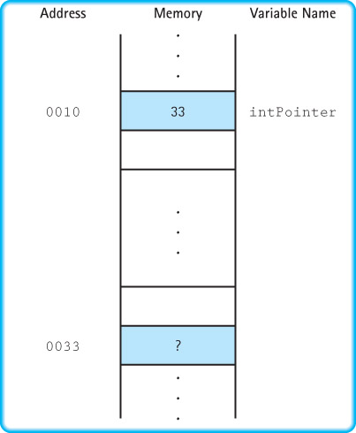
Assign Value to Pointer
int alpha;
int* intPointer;
intPointer = &alpha;
If alpha is at address 33,
memory looks like this
alpha

Slide 27
Pointer Types
2000
12
x
3000
2000
ptr
int x;
x = 12;
int* ptr;
ptr = &x;
Because ptr holds the address of x, we say that ptr “points to” x.

Slide 28
Pointer: Dereference Operator (*)
An operator that, when applied to a pointer variable, denotes the variable to which the pointer points (content)
2000
12
x
3000
2000
ptr
int x;
x = 12;
int* ptr;
ptr = &x;
cout << *ptr;
*ptr is the value in the place to which ptr points

Slide 29
Pointer: Dereference Operator (*)
2000
12 5
x
3000
2000
ptr
int x;
x = 12;
int* ptr;
ptr = &x;
*ptr = 5;
// changes the value
// at address ptr to 5

Slide 30
Pointer Types
char ch;
ch = ‘A’;
char* q;
q = &ch;
*q = ‘Z’;
char* p;
p = q;
// the right side has value 4000
// now p and q both point to ch
4000
A Z
ch
5000 6000
4000 4000
q p

Slide 31
Pointer Types
All pointer variables should be initialized to be NULL
A pointer that points to nothing; available in <cstdlib>
NULL is defined to be 0;
But NULL is not memory address 0
int * intPtr = NULL;
float * money = NULL;
intPtr
money

Slide 32
Review: lifetime of variables or objects
Global variables/objects: start from before the program starts until main() ends
int num;
main(){
….
}
Local variables/objects: declared within the body of a function or a block
Created upon entering the function/block, destroyed upon exiting the function/block
Dynamic variables/objects: created using new(), malloc() calls
Remain alive until delete() is called to free the memory
Destroyed when the program exits

Slide 33
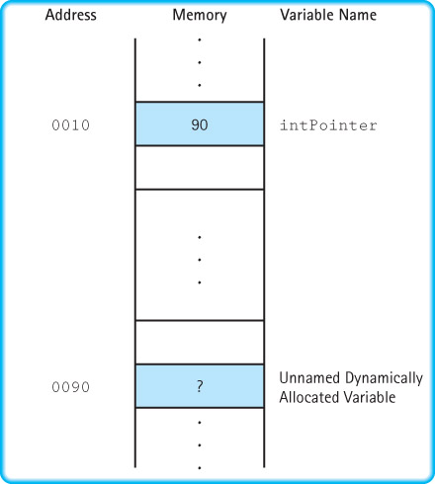
Dynamic allocation (new operator)
Allocation of memory space for a variable at run time (as opposed to static allocation at compile time)
int * intPointer;
intPointer = new int;

Slide 34
Deallocate allocated memory
Dynamically allocated memory needs to be deallocated when it’s no longer used
Otherwise, memory leak will degrade performance
delete operator returns memory to system
delete p;
Value of p is unchanged, i.e. pointing to deallocated memory
Accessing a deallocated memory (*p) can be dangerous
Always set to NULL after deallocation
delete p; // free up memory pointed to by p
p = NULL; // safeguard, extremely important

Slide 35
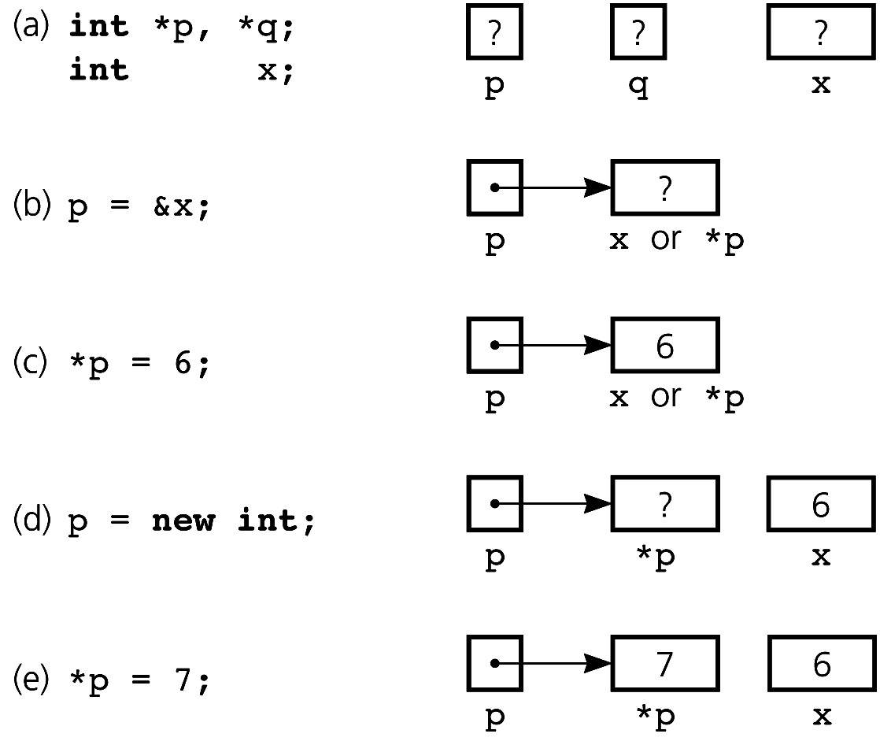
Pointers: examples
(a) Declaring pointer variables; (b) pointing to statically allocated memory; (c) assigning a value;
(d) allocating memory dynamically; (e) assigning a value

Slide 36
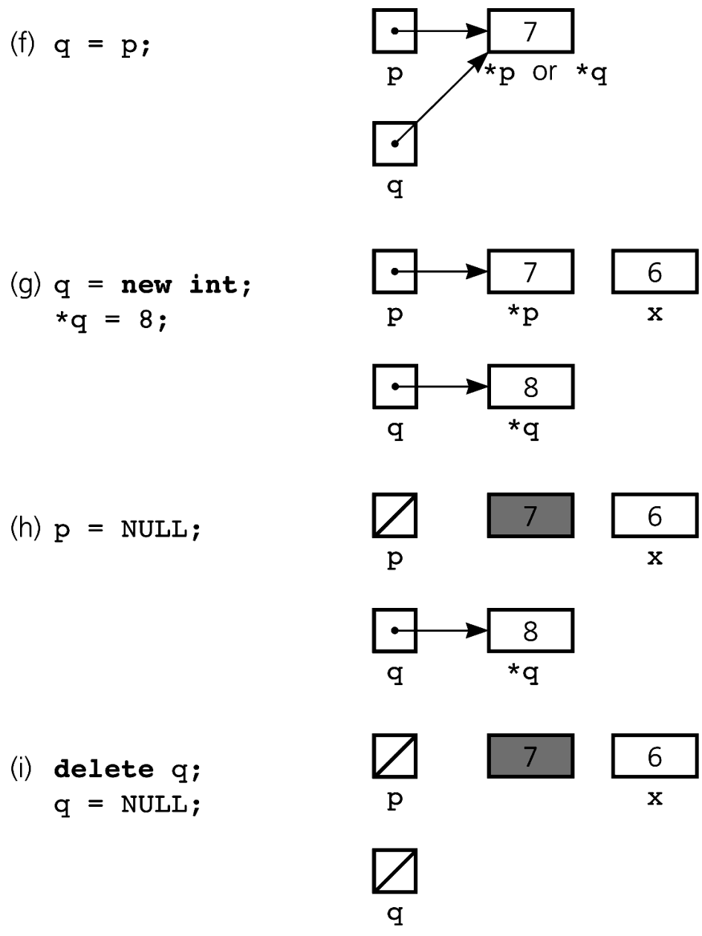
Pointers: example (cont’d)
This memory space cannot be deallocated, as we don’t have a pointer …

Slide 37
Dynamically Allocated Arrays
Use new operator to allocate an array dynamically
int arraySize;
//ask user to enter arraySize…
//
double *anArray = new double[arraySize];
arraySize has a value determined at run time
Dynamically allocated array can be increased
double *oldArray = anArray;
anArray = new double[2*arraySize];
// copy from oldArray to anArray
delete [] oldArray; // deallocate oldArray

Slide 38
Outline
Data structures defintion
Array
Pointer and Dynamic Memory Allocation
Introduction to Abstract Data Types
Object-Oriented Programming
Basic concept: class, object
Encapsulation
Inheritance
Polymorphism

Slide 39
Let’s focus on: Data
Data: the representation of information in a manner suitable for communication or analysis by humans or machines
Data are the nouns of the programming world:
The objects that are manipulated.
The information that is processed.
Different view about data
Application view: What real life objects can be modeled using the data?
Logical view: How to use the data? Operations?
Implementation view: How to implement the data?

Slide 40
C++ Built-In Data Types
Simple
Composite
Integral
Floating
array struct union class
char short int long enum
Address
float double long double
pointer reference

Slide 41
Using C/C++ Data Type
As a C/C++ programmer, we know
Based on the application, we model data as different “variables”
Age: integer
Gender: enumeration
Name: array of char, or string
Also we know what kind of operations each data type supports
We do not worry about how an integer is implemented

Slide 42
C++ programs are users of int
TYPE
int
Value range:
INT_MIN . . INT_MAX
Operations:
+
-
*
/
%
Relational Operators
Representation of
int
as 16 bits two’s
complement
+
Implementation of
Operations
(inside)

Slide 43
Different Views of Data
Application (or user) level modeling real-life data in a specific context
When to use a certain data type?
Logical (or ADT) level abstract view of the domain and operations
How to use the data type?
Implementation level specific representation of the structure to hold the data items, and the coding for operations
How to implement the data type?

Slide 44
Different Views of Data: Library Example
Application (or user) level Library of Congress, or Baltimore County Public Library
A library system can be implemented for Library of Congress…
Logical (or ADT) level domain is a collection of books; operations include: check book out, check book in, pay fine, reserve a book
A library’s necessary functions to the outside world
Implementation level representation of the structure to hold the “books” and the coding for operations
How a specific library is implemented (how are books organized…)?

Slide 45
Different Views of Data
Application (or user) level: modeling real-life data in a specific context.
Logical (or ADT) level: abstract view of the domain and operations. WHAT
Implementation level: specific representation of the structure to hold the data items, and the coding for operations. HOW

Slide 46
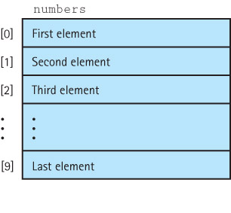
Logical view of array: All a C++ program needs to know
One-dimensional array
A structured composite data type made up of a finite, fixed size collection of ordered homogeneous elements to which direct access is available
Logical level
int numbers[10]

Slide 47
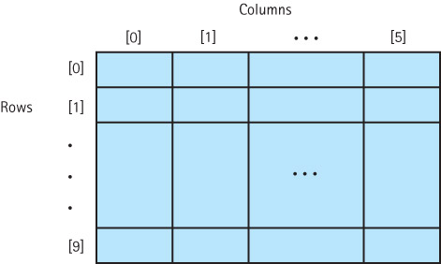
Logical view of 2D array: All a C++ program needs to know
A two-dimensional array
A structured composite data type made up of a finite, fixed size collection of homogeneous elements ordered in two dimensions and for which direct access is provided:
dataTable[row][col]
logical level
int dataTable[10][6];

Slide 48
Many recurrent data types
List
Queue: First In First Out
Operating System: process queues, printing job queue
Stack: Last in First out
Calling stack
Compiler: to parse expressions
Graph:
Model computer network
….
Provide a high-level data type with these logical properties

Slide 49
Data Abstraction: the idea
Data Abstraction: the separation of a data type’s logical properties from its implementation
User of the data type only needs to understand its logical property, no need to worry about its implementation
LOGICAL PROPERTIES IMPLEMENTATION
What are the possible values? How can this be done in C++?
What operations will be
needed?

Slide 50
Abstract Data Type: A logical view
Abstract Data Type is a specification of
a set of data
the set of operations that can be performed on the data
Constructors: to creates new instances of an ADT; usually a language feature
Transformers (mutators): operations that change the state of one or more data values in an ADT
Observers: operations that allow us to observe the state of the ADT
Iterators: operations that allow us to access each member of a data structure sequentially
Abstract Data Type is implementation independent

Slide 51
Outline
Data structures defintion
Array
Pointer and Dynamic Memory Allocation
Introduction to Abstract Data Type
Object-Oriented Programming
Basic concept: class, object
Encapsulation
Inheritance
Polymorphism

Slide 52
OOP & ADT
Object-oriented language provide mechanism for specifying ADT and implementing ADT
Class
An unstructured type that encapsulates a fixed number of data components (data members) with the functions (member functions) that manipulate them
predefined operations on an instance of a class are whole assignment and component access
Client
Software that uses (declares and manipulates) objects (instances) of a particular class to solve some problem

Slide 53
Object-Oriented Programming: Basics
Class
an unstructured type that encapsulates a fixed number of data components (data members) with the functions (called member functions) that manipulate them.
Object
An instance of a class
Method
A public member function of a class
Instance variable (Data Member)
A private data member of a class

Slide 54
Higher-Level Abstraction
Class specification
A specification of the class members (data and functions) with their types and/or parameters
Class implementation
The code that implements the class functions
Why would you want to
put them in separate files?

Slide 55
Classes vs. Structs
Without using public and private, member functions and data are
private by default in classes
public by default in structs.
Usually, there is no member functions defined in structs
struct is passive data
class is active data

Slide 56
class DateType Specification
// SPECIFICATION FILE ( datetype.h )
class DateType // declares a class data type
{
public : // 4 public member functions
DateType (int newMonth,int newDay,int newYear);//constructor
int getYear( ) const ; // returns year
int getMonth( ) const ; // returns month
int getDay( ) const ; // returns day
private : // 3 private data members
int year ;
int month ;
int day ;
} ;

Slide 57
Use of C++ data type class
Variables of a class type are called objects (or instances) of that particular class.
Software that declares and uses objects of the class is called a client.
Client code uses public member functions (called methods in OOP) to handle its class objects.
Sending a message means calling a public member function.

Slide 58
Client Code Using DateType
#include “datetype.h” //includes specification of the class
#include <iostream>
using namespace std;
int main ( )
{
// declares two objects of DateType
DateType startDate ( 6, 30, 1998 ) ;
DateType endDate ( 10, 31, 2002 ) ;
bool retired = false ;
cout << startDate.getMonth( )<< “/” << startDate.getDay( )
<< “/” << startDate.getYear( ) << endl;
while ( ! retired )
{ finishSomeTask( ) ;
. . .
}
return 0;
}
How to dynamically create a DateType object ?

Slide 59
2 separate files for class type
// SPECIFICATION FILE ( datetype .h )
// Specifies the data and function members.
class DateType
{
public:
. . .
private:
. . .
} ;
// IMPLEMENTATION FILE ( datetype.cpp )
// Implements the DateType member functions.
. . .

Slide 60
Implementation of member functions
// IMPLEMENTATION FILE (datetype.cpp)
#include “datetype.h” // also must appear in client code
DateType :: DateType ( int newMonth, int newDay,
int newYear )
// Post: year is set to newYear.
// month is set to newMonth.
// day is set to newDay.
{
year = newYear ;
month = newMonth ;
day = newDay ;
}
:: Scope resolution operator
60

Slide 61
C++ Classes: Constructors
Invoked/called (automatically) when an object of the class is declared/created
A class can have several constructors
A default constructor has no arguments
different constructors with different parameter list (signature)
Eg. DateType can be extended to have the following constructor :
DateType (int secondsSinceEpoch);
The compiler will generate a default constructor if you do not define any constructors

Slide 62
int DateType :: getMonth ( ) const
// Accessor function for data member month
{
return month ;
}
int DateType :: getYear ( ) const
// Accessor function for data member year
{
return year ;
}
int DateType :: getDay ( ) const
// Accessor function for data member day
{
return day ;
}

Slide 63
C++ Classes: Destructors*
Called (automatically) when an object’s lifetime ends
To free up resources taken by the object, esp. memory
Each class has one destructor
If you don’t need to free up resources, you can omit define destructor and the compiler will generate a default destructor

Slide 64
C++ Namespaces*
A mechanism for logically grouping declarations and definitions into a common declarative region
namespace myNamespace
{
// Definitions
// Declarations . . .
} //end myNamespace
The contents of the namespace can be accessed by code inside or outside the namespace
Use the scope resolution operator (::) to access elements from outside the namespace
Alternatively, the using declaration allows the names of the elements to be used directly

Slide 65
C++ Namespace: simple example*
Creating a namespace
namespace smallNamespace
{
int count = 0;
void abc();
} // end smallNamespace
Using a namespace
smallNamesapce::count=0;
using namespace smallNamespace;
count +=1;
abc();

Slide 66
C++ std namespace*
Items declared in the C++ Standard Library are declared in the std namespace
You include files for several functions declared in the std namespace
To include input and output functions from the C++ library, write
#include <iostream>
using namespace std;

Slide 67

Encapsulation
Just as a capsule protects its contents, the class construct protects its data members
// SPECIFICATION FILE ( datetype.h )
class DateType
{
Public :
DateType (int newMonth,int newDay,int newYear);//constructor
int getYear( ) const ;
int getMonth( ) const ;
int getDay( ) const ;
private :
int year ;
int month ;
int day ;
} ;

Slide 68
Object-Oriented Programming
Three ingredients in any object-oriented language
encapsulation
inheritance
polymorphism

Slide 69
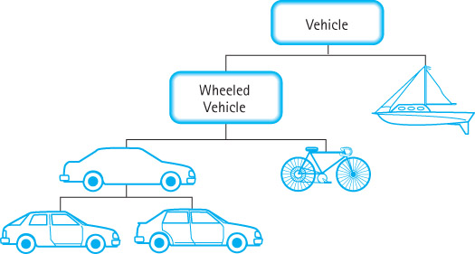
Inheritance
Inheritance: A mechanism used with a hierarchy of classes in which each descendant class inherits the properties (data and operations) of its ancestor class
Base class
The class being inherited from
Derived class
the class that inherits
Inheritance is an "is-a" …

Slide 70
Overriding & Polymorphism
Polymorphism: the ability to determine which of several operations with the same name (within the class hierarchy) is appropriate, either at compiling time (static binding) or run time (dynamic binding)
Overriding
Function with virtual keyword in base class.
Derived classes override function as appropriate.
An overridden function in a derived class has the same signature and return type (i.e. prototype) as the function it overrides in its base class.

Slide 71
Example: polymorphism
#include <iostream>
#include <string>
using namespace std;
class Animal
{
public:
Animal(const string& name) : name(name) {}
virtual string talk() = 0;
const string name;
};
class Cat : public Animal
{
public:
Cat(const string& name) : Animal(name) {}
virtual string talk() { return "Meow!"; }
};
Notes:
71

Slide 72
Example: polymorphism
class Dog : public Animal
{
public:
Dog(const string& name) : Animal(name) {}
virtual string talk() { return "Arf! Arf!"; }
};
// prints the following:
//
// Missy: Meow!
// Mr. Mistoffelees: Meow!
// Lassie: Arf! Arf!
//
Notes:
72

Slide 73
Example: polymorphism
int main()
{
Animal* animals[] =
{
new Cat("Missy"),
new Cat("Mr. Mistoffelees"),
new Dog("Lassie")
};
for(int i = 0; i < 3; i++)
{
cout << animals[i]->name << ": " << animals[i]->talk() << endl;
delete animals[i];
}
return 0;
}
Notes:
73

Slide 74
Example: Overriding
Each class has a method Print
Person.Print just prints the name
Employee.Print prints the name and job title
Manager.Print prints name, job title, and department
Person
Employee
Manager
Print is overriden.
* Static binding is when the compiler can tell which Print to use
* dynamic binding is when the determination cannot be made until run time => use the virtual keyword

Slide 75
Object-Oriented Programming
Inheritance and polymorphism work together to allow programmer to build useful hierarchies of classes that can be put into a library to be reused in different applications
Examples:
Employee class can reuse features implemented at Person class
Only override functions when needed, like print()
A program working for Person class still work for Employee object (through polymorphism)
Print out all persons,…

Slide 76
Miscellaneous: I/O in C++
Header files iostream and fstream declare the istream, ostream,and ifstream, ofstream I/O classes.
Both cin and cout are class objects
These statements declare myInfile as an instance of class ifstream and invoke member function open.
ifstream myInfile ;
myInfile.open ( “A:\\mydata.dat” ) ;

Slide 77
Reference
Reproduced from C++ Plus Data Structures, 4th edition by Nell Dale.
Reproduced by permission of Jones and Bartlett Publishers International.

